Slide 1

Agile/ Lean project management
Let’s Get Started
Notes:
https://www.linkedin.com/learning/paths/become-an-agile-software-developer?u=76192106

Slide 2

Introduction and Special Needs:
Write them down and share with the Class

Slide 3
Scrum Open Assessment ( Pre- Exams ):

Slide 4
Learning objectives:
Demonstrate a good understanding of Agile principles and Manifesto
Demonstrate an excellent understanding of Scrum framework
Demonstrate understanding and ability to apply scrum activities and Tools
Demonstrate ability to implement Agile and lean principles in real life projects

Slide 5
Learning Outline
Agile : Principles, Manifesto and Pillars
Lean : Principles and Type of Waste
Scrum : Activities, Tools and Roles
Kanban: Designing a Kanban

Slide 6

Who has worked on any project in the past? What methodology did you use?

Slide 7
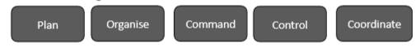
Project management: A Little History
Project management gained recognition as a discipline in 1950s
Born from business administration
Henri Fayol ( “ Father of modern management”)
His work is the grounds for the traditional project management
The manager has 5 basic functions
Until then, project management was focused on large civil engineering and construction

Slide 8

…More History
1960s: software development begins to gain complexity
Software projects used traditional methodologies that were applied to engineering and civil construction projects
Problems begin to emerge:
Software requirements are often emergent
The customer doesn't know exactly what they want before they see the developed parts of the software
But many believed that “problems with communication and understanding of what should be done are responsible for project failure” (Meredith & mantel)

Slide 9
…More History
Software is different
1990: Degrace and Stahl list the factors that make the use of BDUF questionable for software projects
Requirements are not fully understood at the beginning of the project
Users only know what they want after seeing an initial version of the product
Requirements change during the development process
New tools and technologies make the development strategy unpredictable

Slide 10
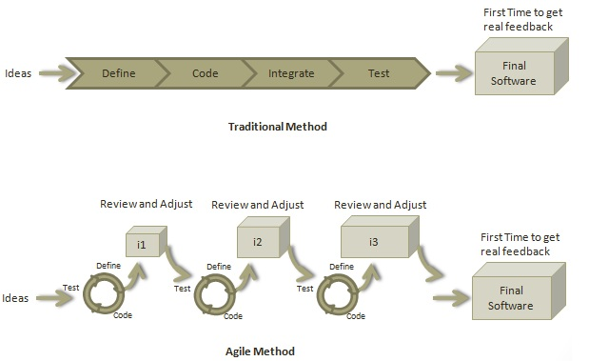
Agile
A development methodology based on iterative and incremental approach of 1 to 4 weeks so that the development process is aligned with the changing business needs.

Slide 11
Agile Vs Traditional

Slide 12
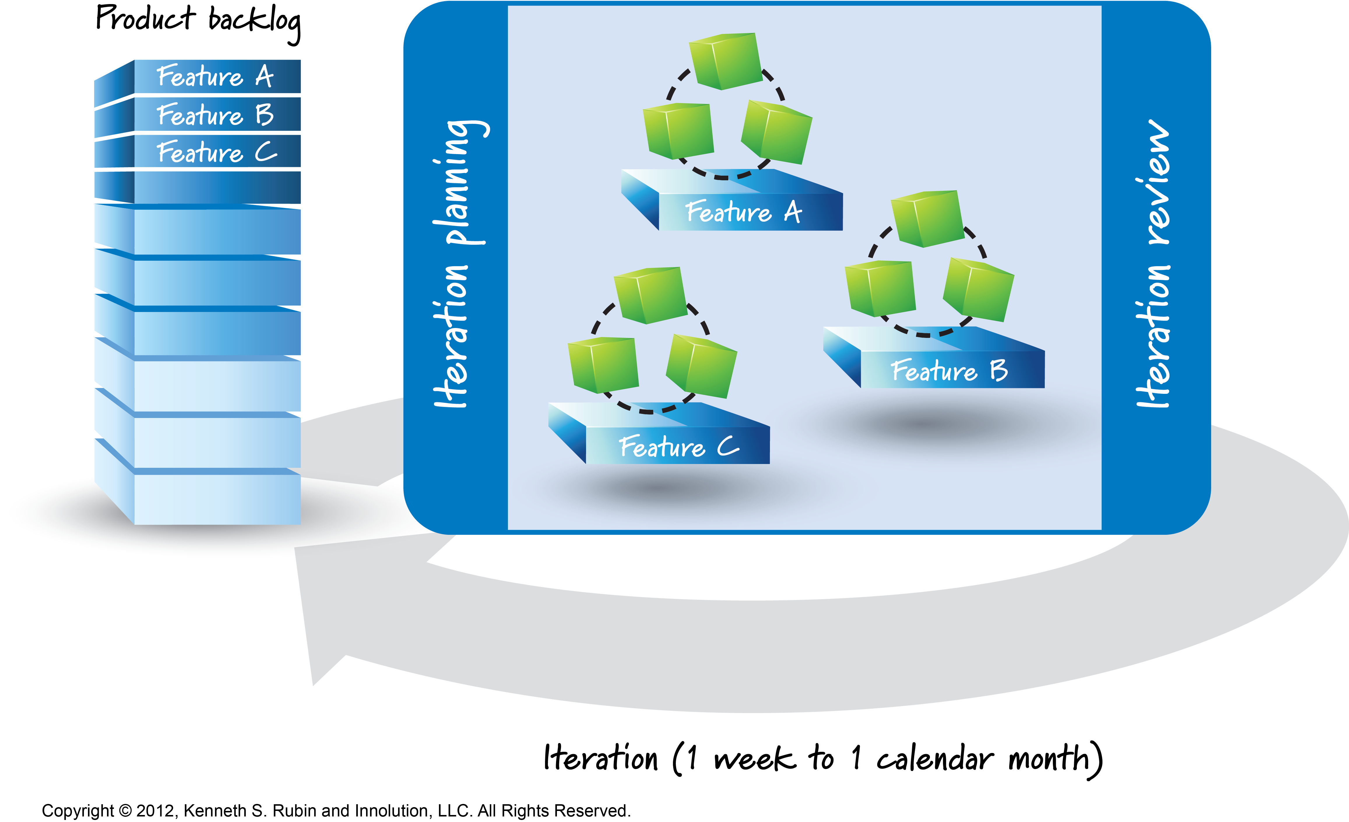
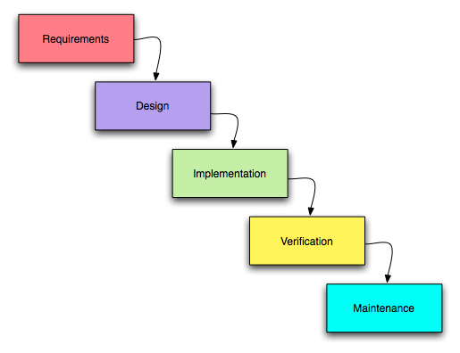
…Agile vs waterfall
Vs

Slide 13



Pillars of Agile
Transparency: Significant aspects of the process must be visible to those responsible for the outcome. Transparency requires those aspects be defined by a common standard so observers share a common understanding of what is being seen
Inspection: Scrum users must frequently inspect Scrum artifacts and progress toward a Sprint Goal to detect undesirable variances
Adaptation: If an inspector determines that one or more aspects of a process deviate outside acceptable limits, and that the resulting product will be unacceptable, the process or the material being processed must be adjusted

Slide 14
Agile Manifesto
Individuals and interactions
over
Processes and tools
Working software
over
Comprehensive documentation
Customer collaboration
Contract negotiation
over
Responding to change
Following a plan
over

Slide 15
Agile Manifesto
Which value statement on the agile manifesto do you think will be the hardest to apply?

Slide 16
12 principles of agile
Our highest priority is to satisfy the customer through early and continuous delivery of valuable software
Welcome changing requirements, even late in the development. Agile processes harness change for the customer’s competitive advantage
Deliver working software frequently, from a couple of weeks to a couple of months, with a preference to the shorter timescale
Business people and developers must work together daily throughout the project

Slide 17
12 principles of agile
Build projects around motivated individuals. Give them the environment and support they need, and trust them to get the job done
The most efficient and effective method of conveying information to and within a team is face to face conversation
Working software is the primary measure of progress
Agile processes promote sustainable development. The sponsors, developers, and users should be able to maintain a constant pace indefinitely
Continuous attention to technical excellence and good design enhances agility
Simplicity – the art of maximizing the amount of work not done – is essential

Slide 18
12 principles of agile
The best architectures, requirements, and designs emerge from self organising teams
At regular intervals, the team reflects on how to become more effective, then tunes and adjusts its behaviour accordingly

Slide 19
12 principles of agile
Sum these up in just a few words

Slide 20

12 principles of agile
Customer Satisfaction
Welcome Change
Frequent Delivery
Work Together
Motivated Individuals
Face To Face Conversation
Close Cooperation
Sustainable Development
Technical Excellence
Simplicity
Self Organising Teams
Inspect And Adapt

